Slide 2
ATAR Human Biology – UNIT 1
Chapter 7 – Blood and Circulation

Slide 3
Circulatory System
Body’s main internal transport system
link between cells inside body and environment outside.
transport link between body systems.
very important in maintaining internal environment at a constant level.

Slide 4
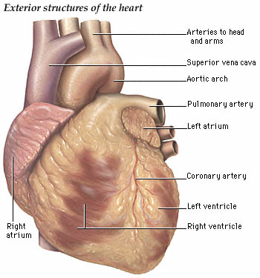
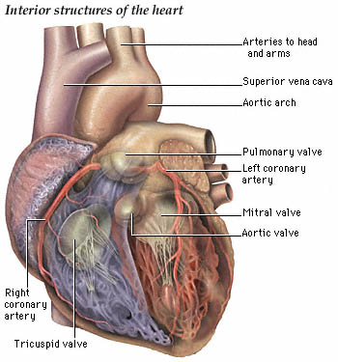
THE HEART AND BLOOD VESSELS
Heart
Four-chambered double pump that pushes the blood around body
Located in the middle of the chest cavity, between the two lungs (in a space called the mediastinum)
Adult heart is about the size of a closed human fist—about 12 cm long, 9 cm across the broadest point and about 6 cm thick.
Membrane around and completely enclosing it – the pericardium – holds it in place but allows it to move as it beats – also prevents heart from overstretching.
Wall of the heart is made up of cardiac muscle.
http://www.ynhh.org/cardiacRW/heart/exterior_heart_anatomy.jpg
http://www.ynhh.org/cardiacRW/heart/interior_heart_anatomy.jpg

Slide 5
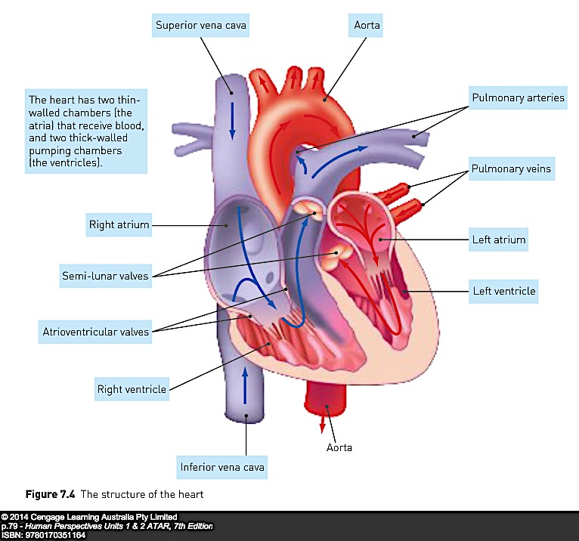

Slide 6
BLOOD FLOW
The cardiac cycle, or heartbeat –
Sequence of events that occurs in one complete beat of heart.
Pumping phase – heart muscle contracts – called systole.
Filling phase – heart muscle relaxes - called diastole.
For a short time both atria and ventricles are in diastole – atria fill with blood and the ventricles also receive blood as the valves between them are open.

Slide 7
Atrial systole – contraction of the atria – follows and forces remaining blood into the ventricles.
Atria now relax and refill while ventricles contract in ventricular systole.
Ventricular systole forces blood into the arteries (Fig. 7.6).
Although the left and right sides of the heart are two pumps, they operate together.
Both atria contract simultaneously, and so do both ventricles.

Slide 8
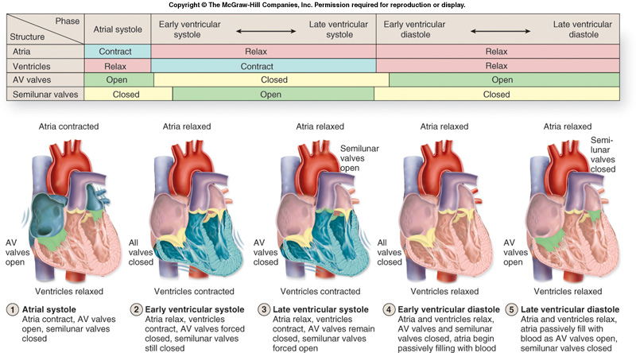

http://www.personal.psu.edu/mjm5267/blogs/202c/cardiac%20cycle.jpg

Slide 9
Cardiac output
Rate of blood flow depends on how fast heart is beating and how much blood heart pumps with each beat.
Heart rate – number of heart beats per minute (bpm)
Stroke volume – volume of blood forced from a ventricle of the heart with each contraction (mL).
Cardiac output – amount of blood leaving one of the ventricles every minute - equal to the stroke volume multiplied by the heart rate:
cardiac output (mL/min) =
stroke volume (mL) × heart rate (bpm)

Slide 10
Changes in blood flow during exercise
During exercise activity of skeletal muscles is greatly increased to bring about movement of body
Requires a large increase in blood flow to ensure an adequate supply of oxygen and nutrients, and to remove carbon dioxide and heat produced.
Cardiac output may increase from 5 L/min at rest to a maximum of 30 L/min in trained athletes.
In physical activity, contracting muscles require extra blood flow.
Other organs do not need extra oxygen and nutrients and do not release extra carbon dioxide
Nervous system and hormone adrenaline cause vasoconstriction in internal organs such as the stomach and intestines, and vasodilation in the muscles.

Slide 11
Blood directed away from those organs that do not require increased blood flow to contracting muscles.
As a person begins exercising, there is an increase in heart rate and stroke volume, and blood flow to skeletal muscles.
As exercise proceeds, muscle cells continue to require energy. Respiration in muscle cells makes energy available but produces large amounts of wastes, including carbon dioxide and lactic acid.
Wastes act as vasodilators of arterioles
results in increased blood flow through muscle tissues ensures cells are adequately supplied with oxygen and nutrients
Cellular respiration releases a lot of heat energy - tends to increase blood temperature – this also contributes to an increase in heart rate.

Slide 12
Important Functions of Blood
Transport of oxygen and nutrients to all cells
Transport of carbon dioxide and other waste products away from cells
Transport of chemical messengers – hormones
Maintaining pH of body fluids
Distributing heat and maintaining body temperature
Maintaining water content and ion concentration of body fluids
Protection against disease-causing micro-organisms
Clotting when vessels are damaged preventing blood loss

Slide 13
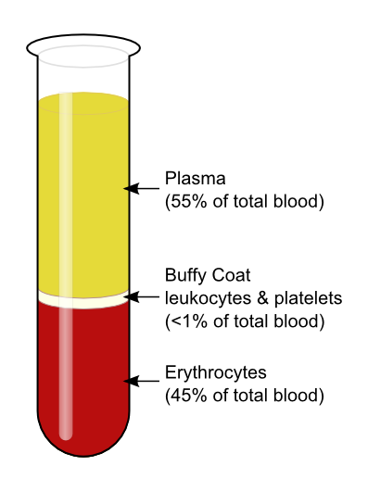

Slide 14
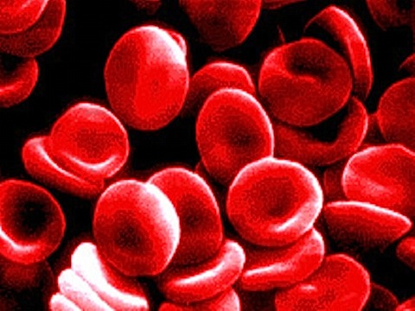
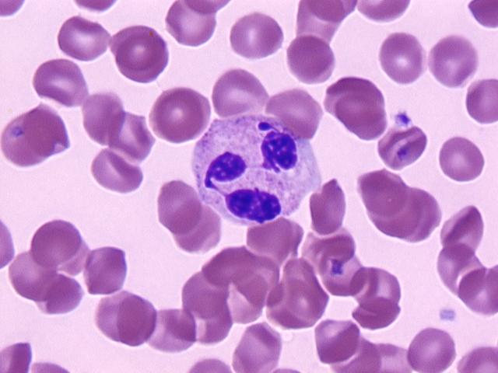
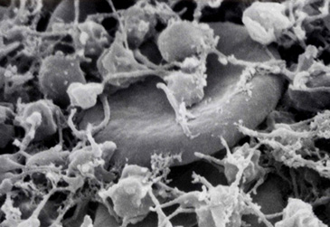
The blood as a transport medium
Blood is made up of
liquid part – plasma (water, proteins and salts)
non-liquid part – cells and cell fragments – formed elements.
Plasma makes up about 55% of blood volume – formed elements make up the other 45%.
Formed elements that are suspended in blood plasma include:
Red blood cells, or erythrocytes;
White blood cells, or leukocytes; and
Platelets, or thrombocytes (Fig. 6.2 on next page).
There are about 4–5 L of blood in an average adult female and about 5–6 L in an adult male.
http://medicineandman.com/blog/wp-content/uploads/2008/08/blood-cells.jpg
http://t0.gstatic.com/images?q=tbn:3mAIwcJRMjYnxM:http://www.uwosh.edu/med_tech/oldsite/images/cell6.jpg
http://biomed.brown.edu/Courses/BI108/BI108_2005_Groups/10/pictures/web/platelets1.jpg

Slide 15
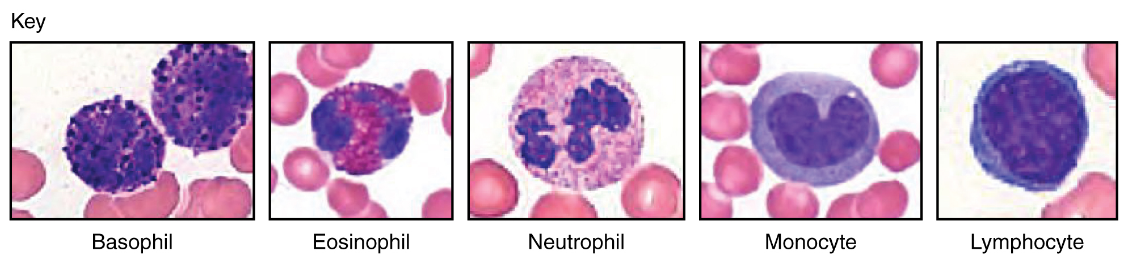
Types of Leukocytes

Slide 16
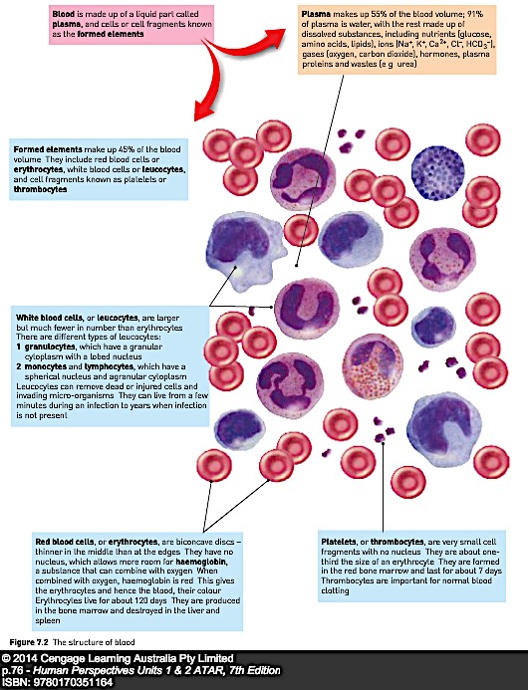

Slide 17
Transport of oxygen
Oxygen not very soluble in water - only about 3% of oxygen is carried in solution plasma.
Other 97% is carried in combination with haemoglobin molecules that are found only in red blood cells.
Haemoglobin is able to combine with oxygen to form oxyhaemoglobin.
Combination of oxygen and haemoglobin is said to be loose because oxyhaemoglobin can easily break apart to release the oxygen:
Hb + O₂ HbO₂
Haemoglobin Oxygen Oxyhaemoglobin

Slide 18
Presence of haemoglobin in red blood cells increases oxygen-carrying capacity by about 60 - 70 times.
Oxygen combines with haemoglobin in lungs where the O₂ conc. is relatively high - O₂ diffuses into blood through alveoli (air sacs).
Oxyhaemoglobin breaks down to Hb and O₂ in situations where the O₂ conc. is relatively low - tissue fluid around cells has a relatively low oxygen concentration.
While flowing through capillaries between cells, red blood cells give up their oxygen, which diffuses into tissue fluid and then into cells (Fig. 7.3)

Slide 19
Transport of carbon dioxide
Carbon dioxide carried in number of ways:
About 7% or 8% dissolved in plasma and carried in solution.
Another 22% combines with globin part of the haemoglobin molecule to form carbaminohaemoglobin.
Remainder - about 70% carried in plasma as bicarbonate ions, HCO₃ – (see Fig. 7.3 and Table 7.1).
As blood flows through capillaries between body cells, CO₂ diffuses from cells into plasma due to the difference in CO₂ conc. (higher CO₂ concentration in tissue fluid and lower CO₂ concentration in plasma).

Slide 20
Some CO₂ dissolves in plasma
Some combines with haemoglobin
most reacts with water to form carbonic acid (H₂CO₃).
Carbonic acid then dissociates into hydrogen ions and bicarbonate ions:
CO₂ + H₂O H₂CO₃ H⁺ + HCO₃–
carbon water carbonic hydrogen bicarbonate
dioxide acid ion ion

Slide 21
Alveoli, are surrounded by a dense network of capillaries.
CO₂ dissolved in plasma in capillaries diffuses out of blood into the air in alveoli.
Carbaminohaemoglobin (HbNHCOOH) breaks down, and CO₂ released diffuses into the alveoli.
Hydrogen ions and bicarbonate ions recombine to form carbonic acid in the plasma, which then breaks down under enzyme action into water and CO₂.
This CO₂ also diffuses into alveoli.
Table 7.1 - Transport of gases in the blood – Relative proportions
Oxygen | Carbon dioxide
3% dissolved in plasma | 8% dissolved in plasma
97% transported as oxyhaemoglobin | 22% as carbaminohaemoglobin
 | 70% as bicarbonate ions

Slide 22
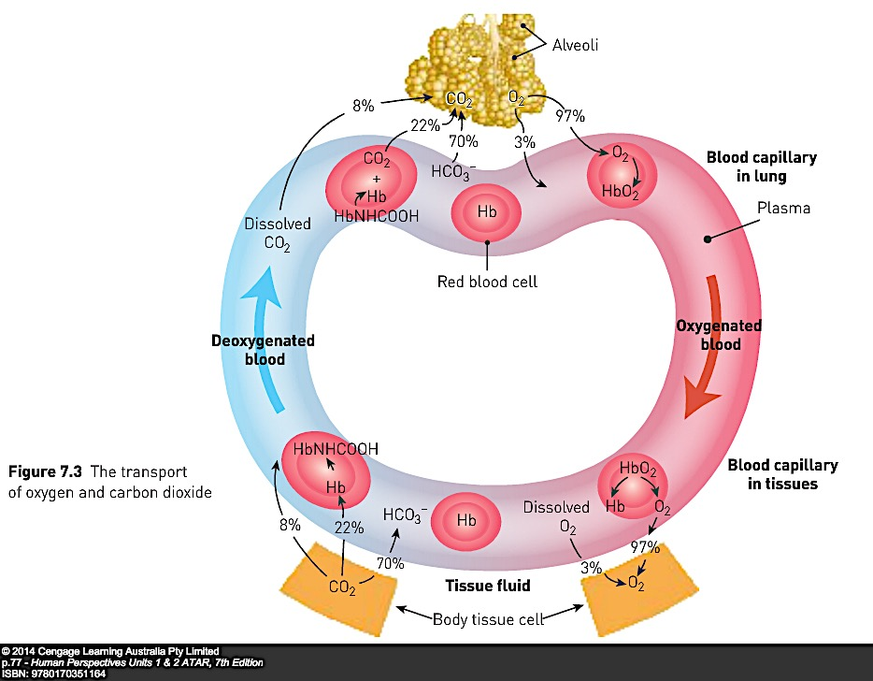

Slide 23
Transport of nutrients and waste
Nutrients and wastes transported dissolved in plasma.
Nutrients – essential elements and molecules obtained from food.
Inorganic nutrients (don’t contain carbon) transported as ions.
E.g. sodium (Na⁺), calcium (Ca₂⁺), potassium (K⁺), chloride (Cl–) and iodide (I–) ions.
Organic nutrients (containing carbon) dissolved in plasma include
glucose,
vitamins,
amino acids,
fatty acids and glycerol.

Slide 24
Wastes, or more correctly, metabolic wastes –
substances produced by cells that cannot be used and would be harmful if allowed to accumulate.
Most important organic wastes that are transported in solution in the blood plasma are
urea,
creatinine and
uric acid.

Slide 25
Blood vessels
Blood is pumped into blood vessels
carry the blood to cells of body or lungs then bring it back to the heart.
Movement of blood is referred to as the circulation.
Blood vessels joined together to form the channels through which the blood flows:
Arteries – carry blood away from the heart
Capillaries – tiny vessels that carry blood between the cells
Veins – carry blood back to the heart.

Slide 26
Blood flow in arteries
Arteries carry blood away from heart – walls contain smooth muscle and elastic fibres.
When the ventricles contract and push blood into the arteries, the walls of the arteries stretch to accommodate the extra blood – produces the pulse.
When the ventricles relax, the elastic artery walls recoil – keeps blood moving and maintains pressure.
Arterial muscle can contract to reduce the diameter of arteries – reduces blood flow to an organ - called vasoconstriction.
Conversely, arterial muscle may relax and increase internal diameter increasing blood flow to an organ — vasodilation.
Allows for changing needs of body.

Slide 27
Large arteries that receive blood pumped by the ventricles divide into smaller arteries.
These in turn divide into very small arteries, known as arterioles – supply blood to the capillaries – arterioles have smooth muscle in their walls.
Contraction or relaxation of this muscle is very important in regulating blood flow through the capillaries – vasoconstriction and vasodilation
Veins – blood vessels that carry blood towards heart
Do not have muscular walls - not able to change their diameter in the way that arteries do.
Similarly, venules - tiny veins that carry blood away from capillaries, do not have muscle in their walls that can change their diameter.

Slide 28
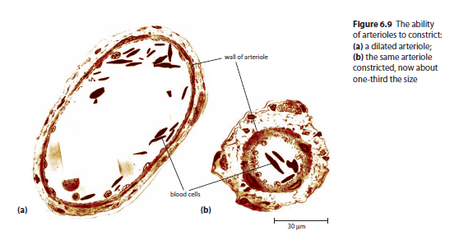

Slide 29
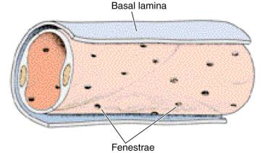
Capillaries:
Microscopic blood vessels that form a network, carrying blood close to every cell.
Enables cells to get their requirements from blood and to pass their waste into blood.
structure of capillaries suits their function.
Capillary walls only one layer of cells – allows substances to pass easily (and rapidly) between blood and surrounding cells.

Slide 30
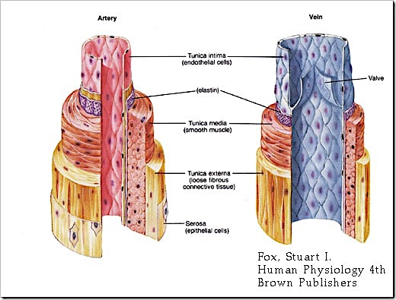

Slide 31
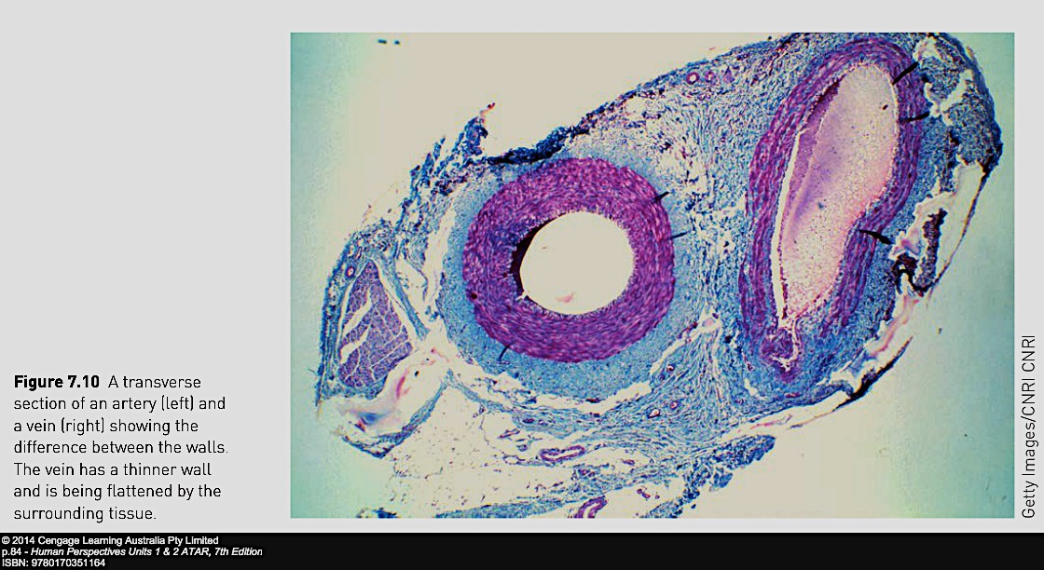
Comparison of cross-section between an artery and a vein

Slide 32
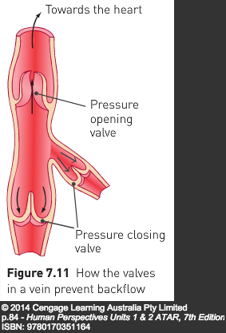
Movement of blood back to heart
Blood in veins under low pressure.
Blood is unable to move back to the heart solely from heart contractions alone.
Loss of pressure is too great
Skeletal muscle movements push against sides of flexible large veins
Causes blood to push back against one-way valves in veins
Valves close preventing backflow
Blood is forced to move towards the heart.
Process is called venous return

Slide 33
Differences between arteries and veins
Arteries | Veins
Carry blood away from the heart | Carry blood towards the heart
Have a blood pressure that increases as the ventricles contract and decreases as the ventricles relax | Have a constant, relatively low blood pressure
Have thick, muscular, elastic walls | Have thin, relatively inelastic walls with little muscle
Have no valves | Often have valves

Slide 34
Blood Clotting
Following injury involving blood vessel damage, events occur that help to minimise blood loss and prevent microbial infection
Arterial smooth muscle constrict to reduce blood flow
Rough surfaces of damaged blood vessels allow platelets to stick
Allows other platelets to also stick creating a plug.
Platelets release vasoconstrictor chemicals – enhance and prolong constriction
Above sufficient to stop bleeding in small capillary injuries

Slide 35
More serious injuries require a blood clot (coagulation of blood):
Requires formation of clotting factors present in plasma
Chemicals reactions create insoluble protein called fibrin
Fibrin threads form a mesh – traps rbc’s, platelets and plasma.
Threads hold the clot in position
Clot shrinks – clot retraction – threads contract, pull edges of blood vessels together – squeezes out fluid called serum
Clot dries forming a scab

Slide 36
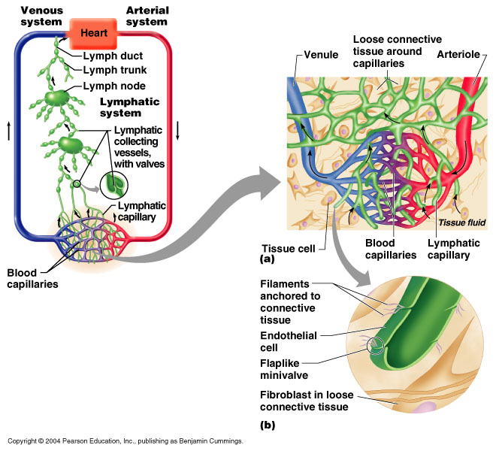
THE LYMPHATIC SYSTEM

Slide 37
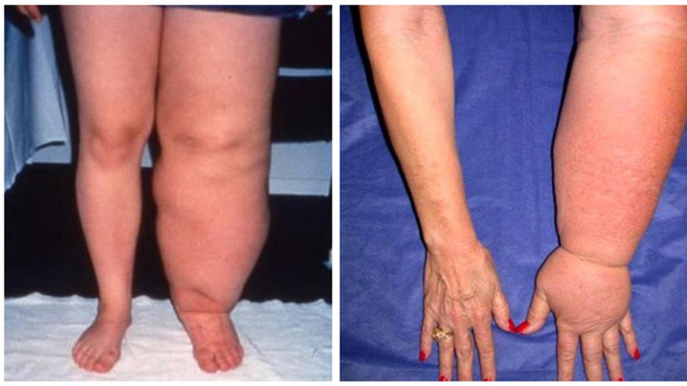

Slide 38
THE LYMPHATIC SYSTEM
Fluid forced from blood stream in capillaries into the tissues due to high pressure.
Lymphatic system collects fluid to
Return it to blood stream
Filter out disease-causing microorganisms
Consists of
A network of lymph capillaries joined to larger lymph vessels
Lymph nodes located along the length of larger lymph vessels

Slide 39
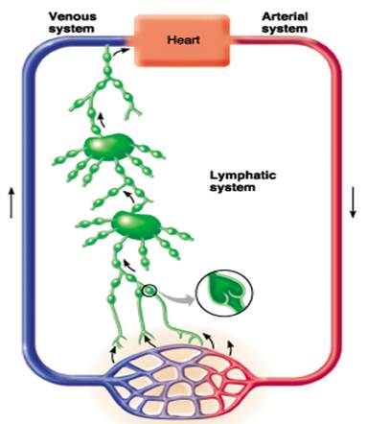
LYMPHATIC SYSTEM
Essentially a drainage system accessory to venous system
larger particles that escape into tissue fluid can only be removed via lymphatic system

Slide 40
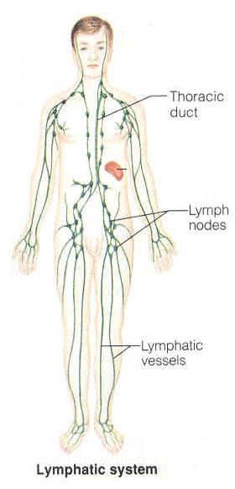
Components of the Lymphatic System
Lymph
Lymphatic Vessels
Lymphatic Capillaries
Lymphatic Vessels
Lymphatic Trunks
Lymphatic Ducts
Lymphatic Organs
Thymus
Lymph Nodes
Spleen
Tonsils
Lymphatic cells

Slide 41
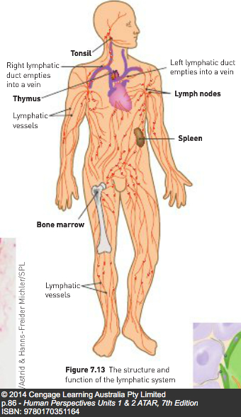

Slide 42
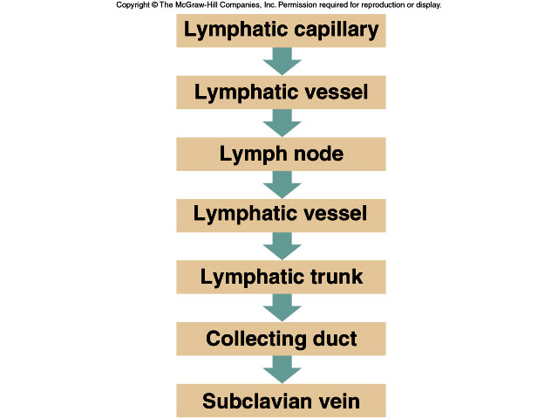

Slide 43
Lymph
Tissue fluid (interstitial fluid) that enters the lymphatic vessels
Similar to plasma
Contains large proteins and disease-causing microorganisms

Slide 44
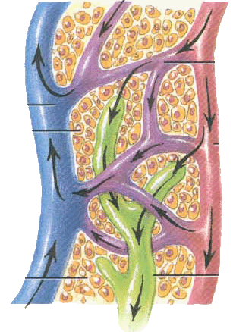
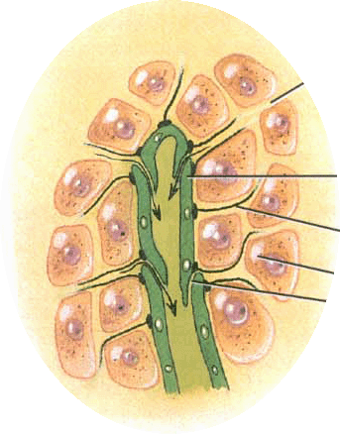
Lymphatic Capillaries
Features of structure:
Blind end
Single layer of overlapping endothelial cells
More permeable than that of blood capillary
Absent from avascular structures, brain, spinal cord splenic pulp and bone marrow

Slide 45
Lymph Vessels
Blind ended tubes in spaces between cells of most tissues
Slightly larger than blood capillaries
More permeable than capillaries
Network joins to form two large lymphatic ducts that empty lymph into the L & R Subclavian veins

Slide 46
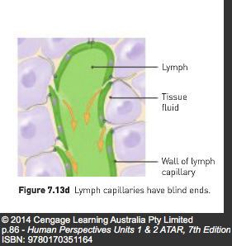
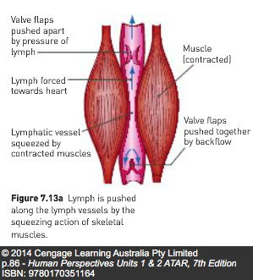
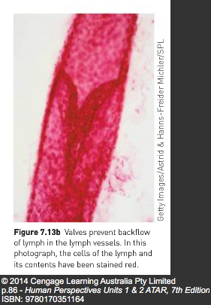

Slide 47
Lymph Nodes
Also called lymph glands
Occur at intervals along lymphatic vessels
Most numerous in neck, armpits, groin and around alimentary canal (digestive tract)
Bean shaped length betw. 1mm to 25mm
Capsule of connective tissue forms a network
Contain masses of lymphoid tissue – cells known as lymphocytes, macrophages, plasma cells.

Slide 48
Role of lymphatic system in defence against disease
Lymph entering nodes contains cell debris, foreign particles and microorganisms
Some are able to cause disease
Larger particles trapped in lymphoid tissue
Macrophages consume these by phagocytosis.
Most bacteria destroyed in this way in 10-30 minutes
During infections, numbers of lymphocytes increase, lymph nodes become sore and swollen.
Infection in the finger may cause painful swelling in the armpit.

Slide 49
Blood groups and Transfusions
Given to people who suffer excessive blood loss, anaemia, leukaemia, haemophilia, etc.
Blood or blood product injected into patient's bloodstream
Two grouping systems
ABO
Rh

Slide 50
ABO Blood Groups
Antigen – any substance able to stimulate the formation of antibodies.
Antibodies – proteins produced to combine with specific antigens
ABO blood grouping – two antigens on RBC’s
Either antigen A or
Antigen B,
Both antigen A & B, or
Neither antigen A nor B.
These are four possibilities that correspond to four human blood types – A, B, AB, or O

Slide 51
Blood type is an inherited characteristic
Antibodies are produced in response to these antigens.
Antibody A (anti-A) reacts against antigen A
Antibody B (anti-B) reacts against antigen B
You normally do not produce antibodies to your own blood type, so
Type A person will produce anti-B
Type B person will produce anti-A
Type AB person will produce no antibodies, so
Type O person will produce both antibodies

Slide 52
Blood group | Antigens on red blood cells | Antibodies in plasma
A | Antigen A | Anti-B
B | Antigen B | Anti-A
AB | Antigens A & B | Neither Anti-A nor Anti-B
O | Neither Antigen A nor B | Both Anti-A and Anti-B

Slide 53
Rh Blood groups
Person with Rh antigens – Rh+
Person without Rh antigens – Rh-

Slide 54
Transfusions
Mixing of blood types causes antibodies to react against antigens – causes erythrocytes to clump together – called agglutination
Most important during transfusions that the recipient is given the correct blood type

Slide 55
Types of transfusions
Whole blood – as it is taken from donor but with an anti-coagulant added – for massive blood loss
Red cell concentrates – most plasma removed – for heart patients or severe anaemia
Plasma – for patients who require extra clotting factors to control severe bleeding or for those with liver disease.

Slide 56
Platelet concentrates – to replace low numbers of platelets
Cryoprecipitate frozen plasma – for haemophilia or severe bleeding
Immunoglobulin – antibody proteins – for antibody deficiency or for those with reduced immunity
Autologous transfusion – patient’s own blood is used. Blood collected prior to an operation and stored – used for elective surgery

